Slide 1


Using ChatGPT unscripted
Notes:
https://openai.com/blog/introducing-the-gpt-store

Slide 2
Let’s do this!
Use ChatGPT for learning new things
Use ChatGPT to augment your work or home experience
Use ChatGPT for quick research
Use ChatGPT for brainstorming
Use ChatGPT for creative writing
Use ChatGPT for translation
Use ChatGPT for summarizing text
Use ChatGPT for code generation
Use ChatGPT for data analysis
Use ChatGPT for creating presentations
Use ChatGPT for social media content creation
Use ChatGPT for email writing

Slide 3
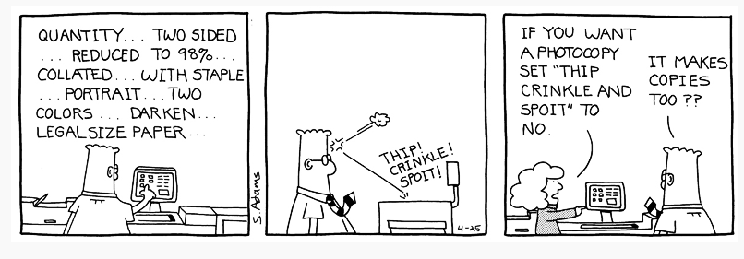

Slide 4
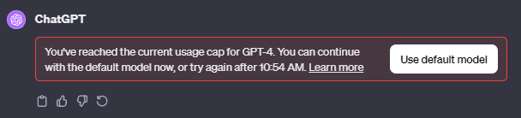
You will Likely hit your usage cap

Slide 5
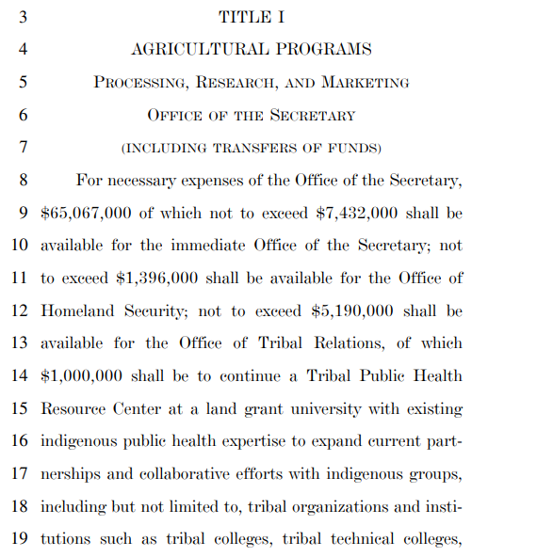
Use ChatGPT for learning new things

Slide 6
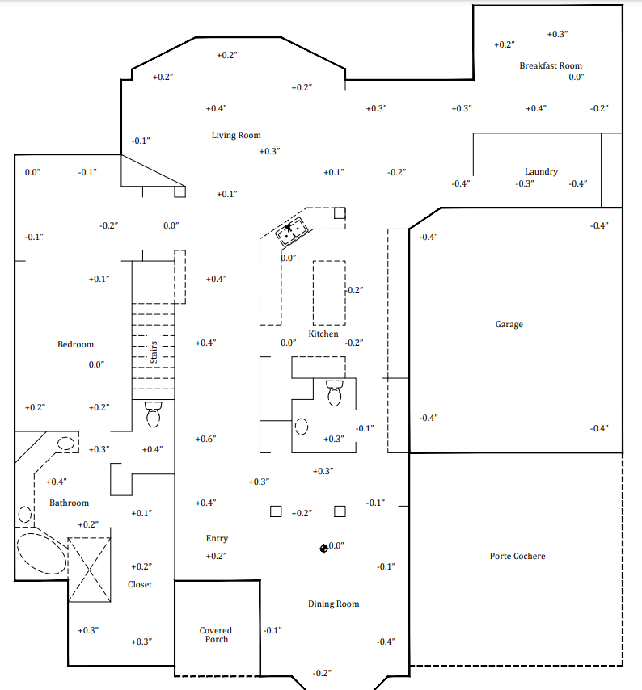
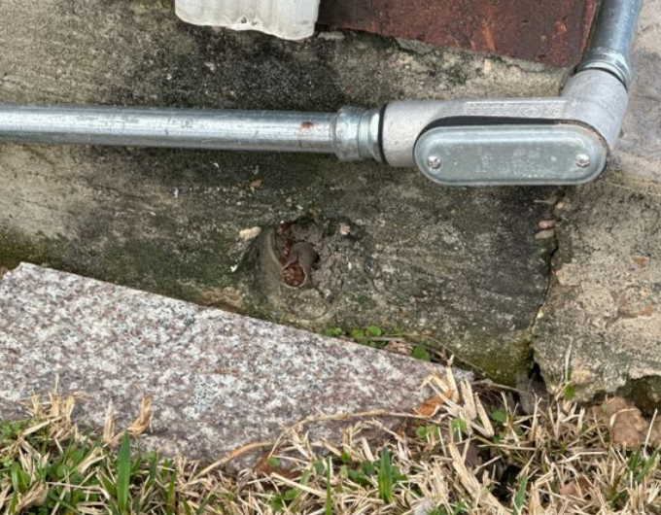
Use ChatGPT to augment your home experience

Slide 7
Use ChatGPT to augment your work experience
Notes:
https://generativeai.pub/boost-your-gpts-potential-with-co-star-framework-prompt-e53ed0917df0
https://chromewebstore.google.com/detail/co-star-prompt-template/hkcehkkpooflpbalgpbamjnfdpabeekb

Slide 8
Use ChatGPT for quick research

Slide 9
Use ChatGPT for brainstorming

Slide 10
Use ChatGPT for creative writing

Slide 11
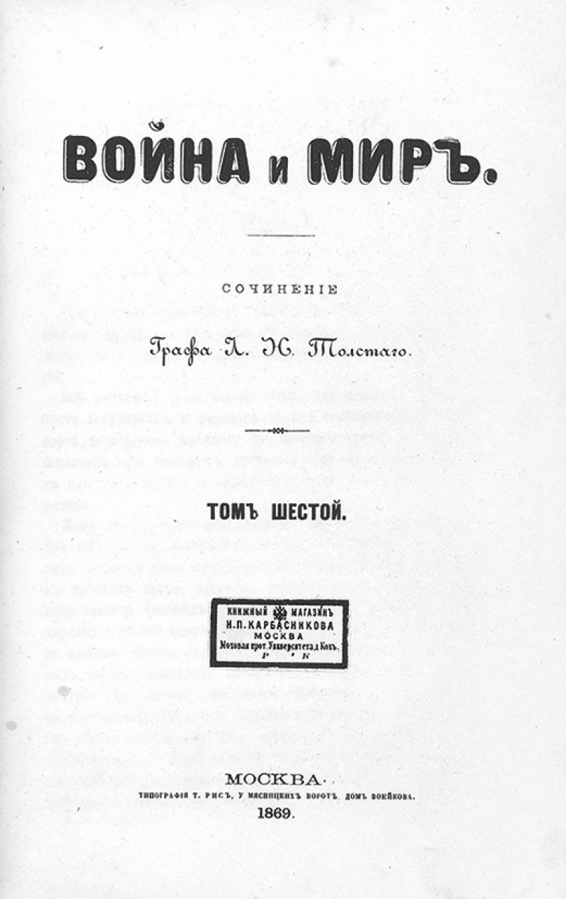

Use ChatGPT for translation

Slide 12
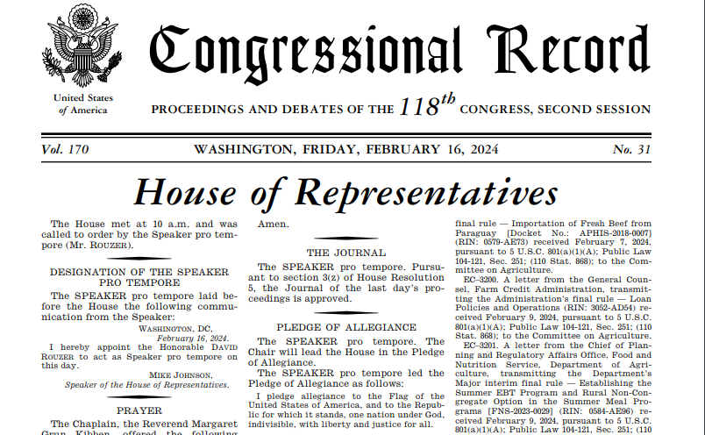
Use ChatGPT for summarizing text

Slide 13
Use ChatGPT for code generation

Slide 14
Use ChatGPT for data analysis

Slide 15
Use ChatGPT for creating presentations

Slide 16
Use ChatGPT for social media content creation

Slide 17
Use ChatGPT for email writing

